Slide 1

Academic Year 2025 - 26 S7 MINI PROJECT - I Zeroth Review
PROJECT TITLE
BIT Automated Student Leave & Outpass Management System with Parent Notification Workflows
PROJECT ID
2026AC581
CATERGORY
INTERNAL
SUBMITTED BY
SUGANTHAN S V (7376231EC298)
VIBIN V (7376231EC316)
THARUN PRASATH C (7376231EC308)
GUIDE
INDHU BHASHINI V
Assistant Professor
Department of Information Technology

Slide 2
PROBLEM STATEMENT
Existing Problems:
Leave requests are handled manually using paper forms.
Students must visit multiple authorities for approvals.
Parents are not informed immediately after leave approval.
Security verification at the campus gate is manual.
No centralized record of student entry and exit.
Difficult to track leave history and reports.

Slide 3
AIM & OBJECTIVES
Aim:
To develop a secure web-based Leave and Outpass Management System that automates the approval process, generates QR codes for gate verification, and notifies parents about student movements.
Objectives :
Digitize leave and outpass requests.
Automate the approval workflow.
Generate secure QR codes.
Enable QR-based gate verification.
Send automatic parent notifications.
Maintain centralized leave records.
Provide role-based access for different users.

Slide 4
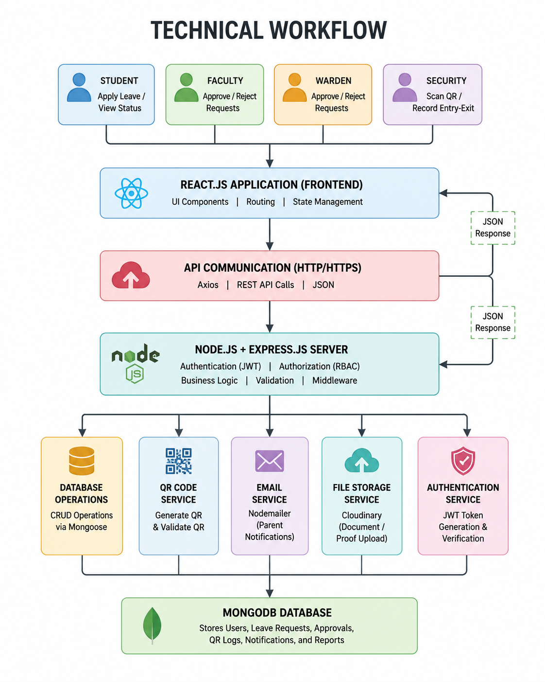
WORKFLOW

Slide 5
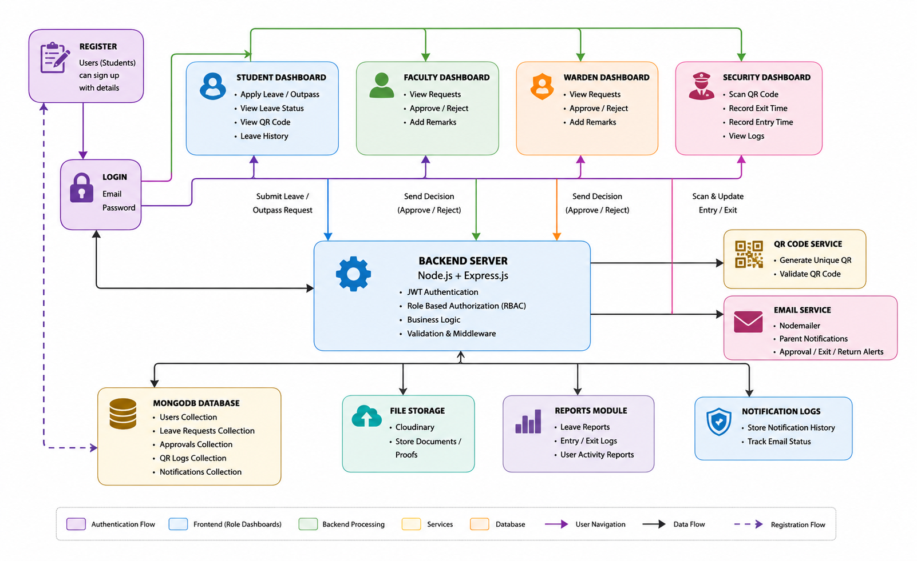
ARCHITECTURE DIAGRAM

Slide 6
CHOICE OF COMPONENTS / MODULES / METHODS/TECHNIQUES EQUIPMENT USED FOR PROJECT DEVELOPMENT
TECHNOLOGIES USED:
Frontend: React.js, Tailwind CSS
Backend: Node.js,Express.js
Database: MongoDB Atlas
Authentication: JWT + Google Auth
QR Code: qrcode, html5-qrcode
Cloud Storage: Cloudinary
PWA: Service Workers
Notifications: Nodemailer
Version Control: Git & GitHub
Deployment: Vercel (Frontend), Render (Backend)

Slide 7
EXPECTED OUTCOME
Paperless leave management.
Faster approval process.
QR-based secure gate verification.
Automatic parent notifications.
Real-time leave tracking.
Centralized database.
Improved campus security.
Reduced manual work.

